Slide 1


“Employee Leave Management System”
Submitted by: Utkarsh Tiwari
Submission type : Individual
Name: Office Leave Management Application
Batch : B-12
LMS Id :
Program : AXIS FINTECH
Date: 31/05/2023

Slide 2

Table of contents
Introduction
Project Overview
Architecture Design
User Interface Design
Back-end Development
Front-end Development
Testing
Deployment
Conclusion
Future Work
References
Appendices

Slide 3
Introduction
A project that deals with managing employees in a workspace by eliminating some of the manual tasks and making things more easier than before, it's a web application built using Spring framework of Java along with other technologies.
This project has a separate dashboard for the employees and admins of an organization, both have different sets of access that makes them apart. An admin has full control over the employees while an employee has access to their own profile and can apply for an leave or can contact to system admins.

Slide 4
Project Overview
This project has a separate dashboard for the employees and admins of an organization, both have different sets of access that makes them apart. An admin has full control over the employees while an employee has access to their own profile and can apply for an leave or can contact to system admins.
Admin Privileges
1. Has the full access to the system and can view the profiles of employees
2. Can create/edit/delete an employee
3. Can send email to the employees individually
4. Can respond to the leave requests via email with ready to use templates
5. Can fetch the employee data with their id
Employee Privileges
1. Can see their profile and update it
2. Can apply for multiple leave and will receive an email upon approval/disapproval of their leaves
3. Can contact system administrator

Slide 5
Project Overview
Technologies Used
1. Java
2. Spring MVC
3. MySQL
4. Maven
5. JSP
6. HTML/CSS/JS/Bootstrap
7. RESTful APIs

Slide 6
Project Overview
Functionalities In Project
1. Log in
2. Forgot password
3. Register new Employee
4. Apply for leave
5. Delete employee
6. Send mail to employee
7. Accept or reject leave request
8. Manage Calendar
9. Find employee by ID
10. Update employee

Slide 7
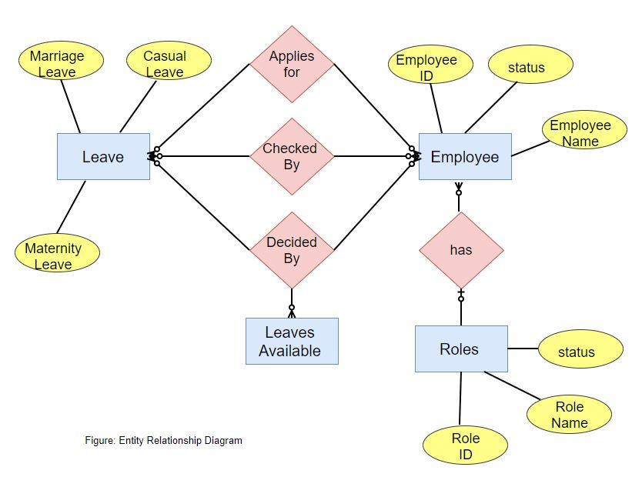
Architecture Design

Slide 8
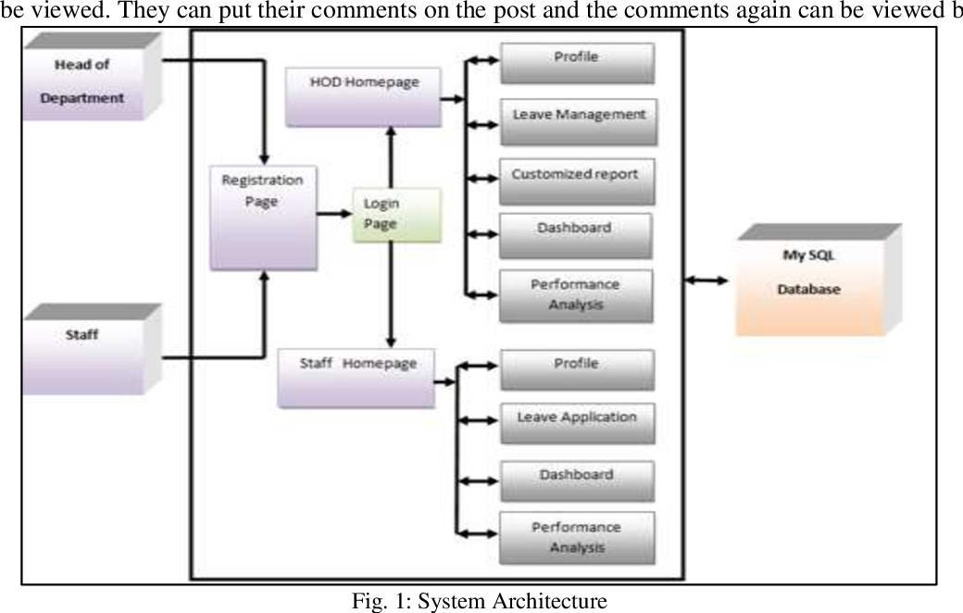

Slide 9
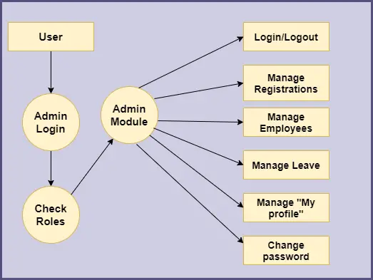
User Interface Design
Admin Module UI Design

Slide 10
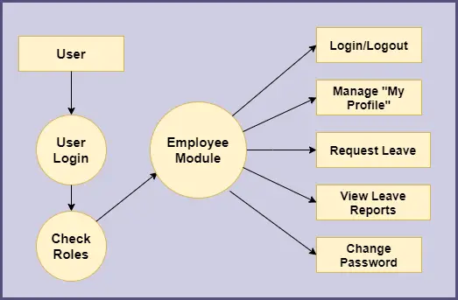
User Interface Design
Employee Module UI Design

Slide 11
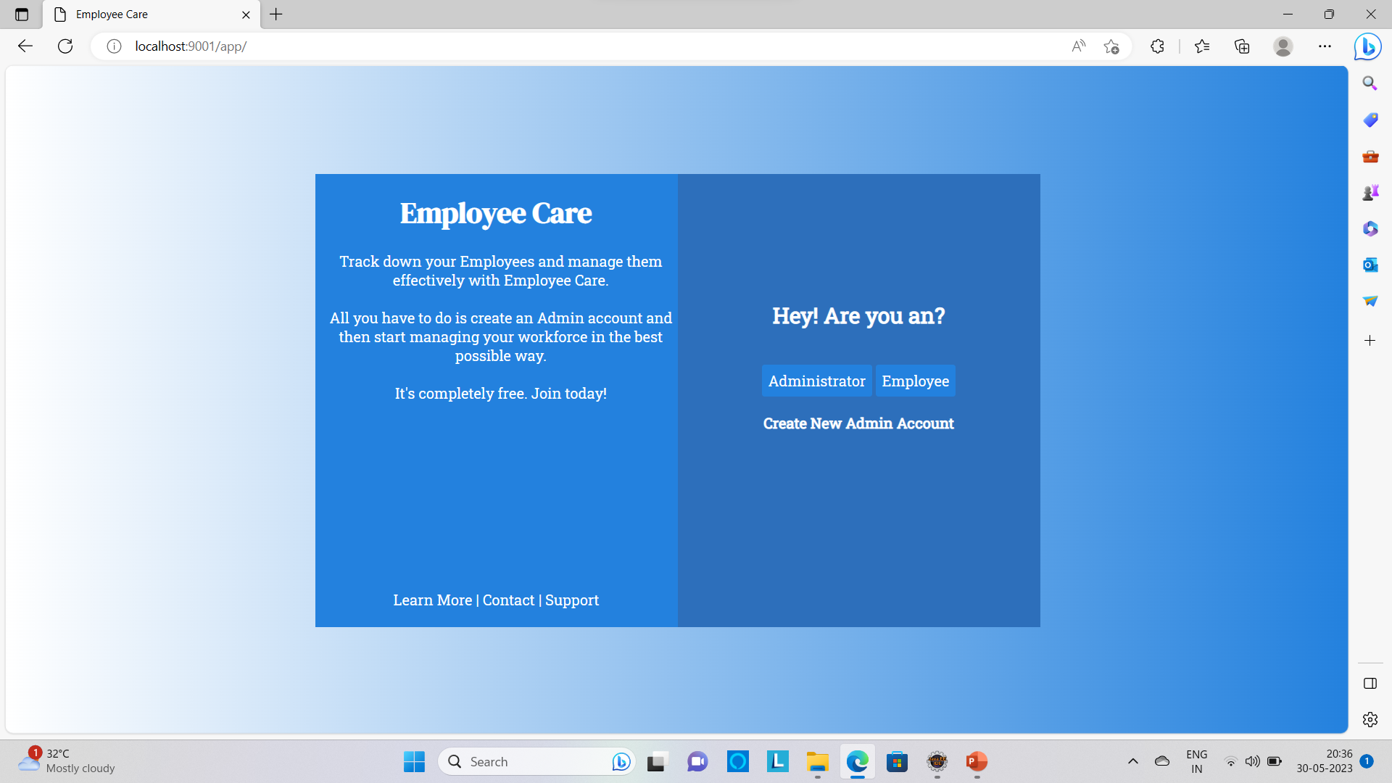
User Interface Design
Home page UI

Slide 12
Back-end Development
The backend of the Employee Leave Management project is developed using Spring Boot, Maven, JSP, JPA, Hibernate, validation, controllers, services, repositories, and DTOs. Mail sender is also used to send emails to users. The database used is MySQL.
Spring Boot is a popular framework for developing Java applications. JSP is a server-side scripting language that is used to create dynamic web pages. JPA is a Java persistence API that provides a standard way to access and manage data in a relational database. Hibernate is an open-source object-relational mapping (ORM) tool that provides a JPA implementation. DTOs are used to transfer data between different layers of the application. Mail sender is used to send emails to users. MySQL is a popular relational database management system (RDBMS).
The backend of the Employee Leave Management project is developed using a number of popular and well-tested technologies. This ensures that the project is well-designed and easy to maintain.

Slide 13
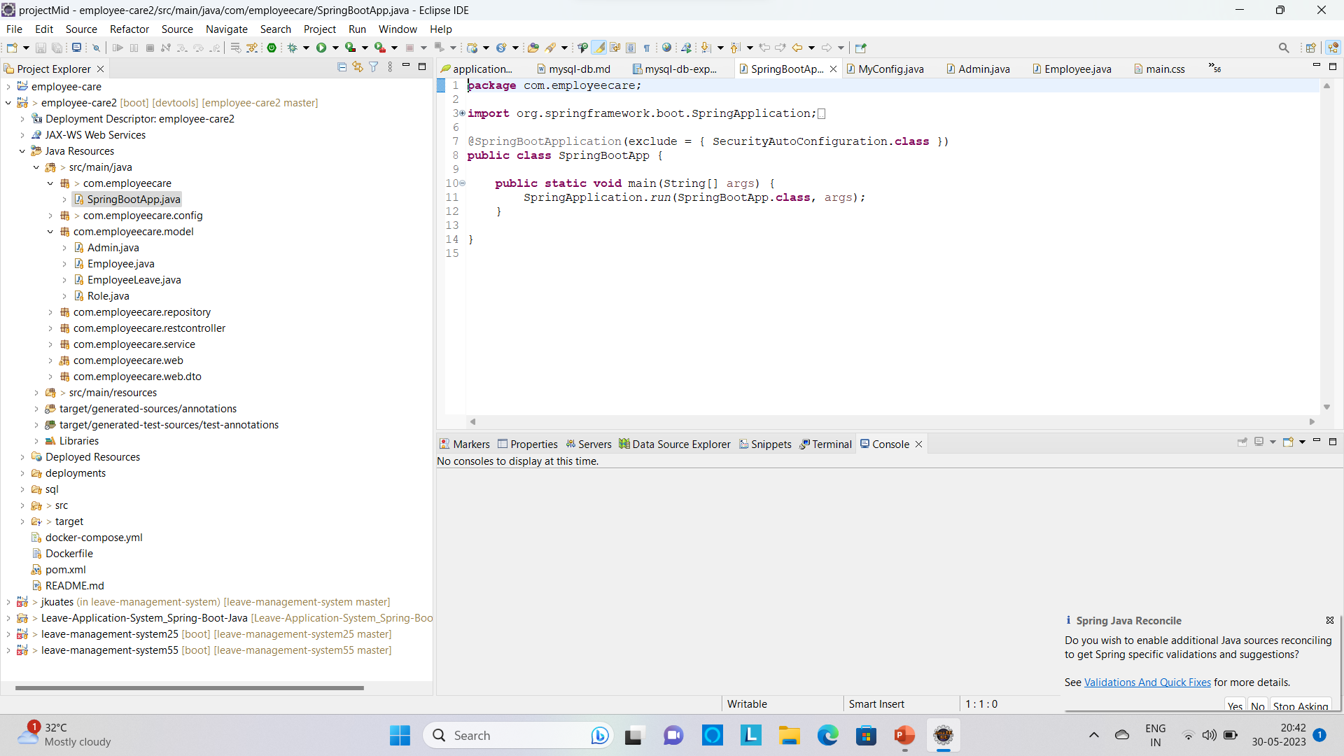
Back-end Development

Slide 14
Front-end Development
The front-end development of the "Employee Leave Management" project involved the use of HTML, CSS, Bootstrap, JavaScript, and Java Server Pages (JSP). This project is built using the Spring Boot framework, which provides a robust and efficient foundation for developing web applications.
HTML (Hypertext Markup Language) was used to structure the web pages and define the content elements. CSS (Cascading Style Sheets) was utilized for styling and layout purposes, ensuring a visually appealing and consistent user interface. JavaScript was employed to add interactivity and enhance the user experience through client-side scripting.
Java Server Pages (JSP) were utilized to dynamically generate HTML content and integrate Java code into the web pages. JSP allows for the separation of presentation logic from business logic, enabling developers to build dynamic and data-driven web pages efficiently.
By leveraging HTML, CSS, JavaScript, and JSP within the Spring Boot framework, the front-end development of the "Employee Leave Management " project delivered an intuitive and user-friendly interface for managing employee leave and related activities.

Slide 15
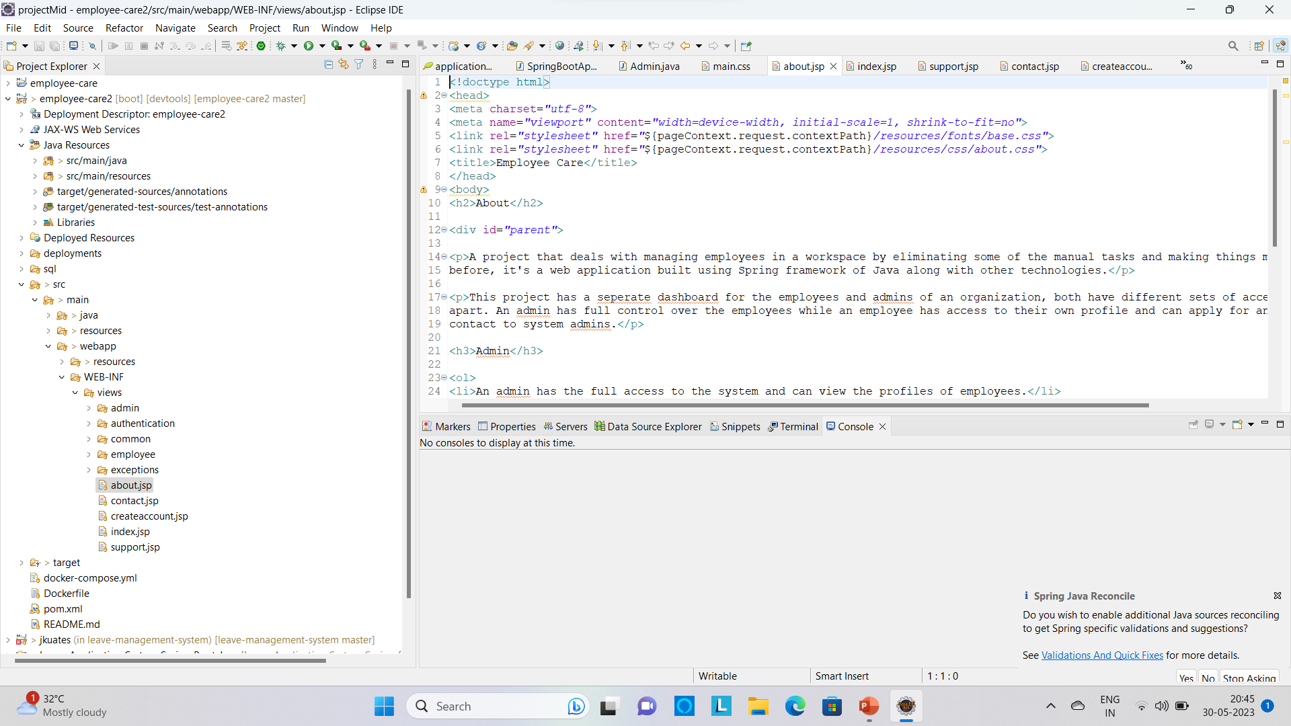
Front-end Development

Slide 16
Integration and Testing
This section explains the testing methodology used to ensure that the application works as expected, including unit tests, integration tests, and end-to-end tests.

Slide 17
Deployment
This section explains the deployment process used to deploy the application to a production environment, including the hosting platform, the deployment process, and the configuration of the environment.

Slide 18
Conclusion
In conclusion, the Employee Leave Management System is a robust solution that combines HTML, CSS, JavaScript, and Java Server Pages, Springboot MVC to deliver a user-friendly and efficient leave management interface. By leveraging these technologies, the system enables organizations to streamline the leave management process, improve productivity, and enhance employee satisfaction.

Slide 19
Conclusion
In conclusion, the Employee Leave Management System is a robust solution that combines HTML, CSS, JavaScript, and Java Server Pages, Springboot MVC to deliver a user-friendly and efficient leave management interface. By leveraging these technologies, the system enables organizations to streamline the leave management process, improve productivity, and enhance employee satisfaction.

Slide 20
Future Work
Here are some additional functionalities that can be added to employee leave management systems:
Attendance management: The future scope of attendance management involves leveraging emerging technologies and data analytics for optimized workforce management and improved employee experience.
Time tracking: time tracking involves leveraging advanced technologies and automation for accurate, real-time tracking of work hours and tasks.
Document management: Document management systems can store and organize employee documents, such as leave requests, performance reviews, and employee handbooks. This can help to ensure that documents are easy to find and that they are kept confidential.
Issue and request management: Issue and request management systems can track employee issues and requests. This information can be used to identify trends and to improve the employee experience.
By adding these features, employee leave management systems can become more effective and efficient. This can help organizations to improve employee satisfaction, productivity, and compliance.

Slide 21
References
https://www.baeldung.com/spring-boot-start
https://www.geeksforgeeks.org/introduction-to-jsp/
Hibernate Tutorial (tutorialspoint.com)
https://www.tutorialspoint.com/hibernate/index.htm
W3Schools Online Web Tutorials
https://www.baeldung.com/spring-email

Slide 22
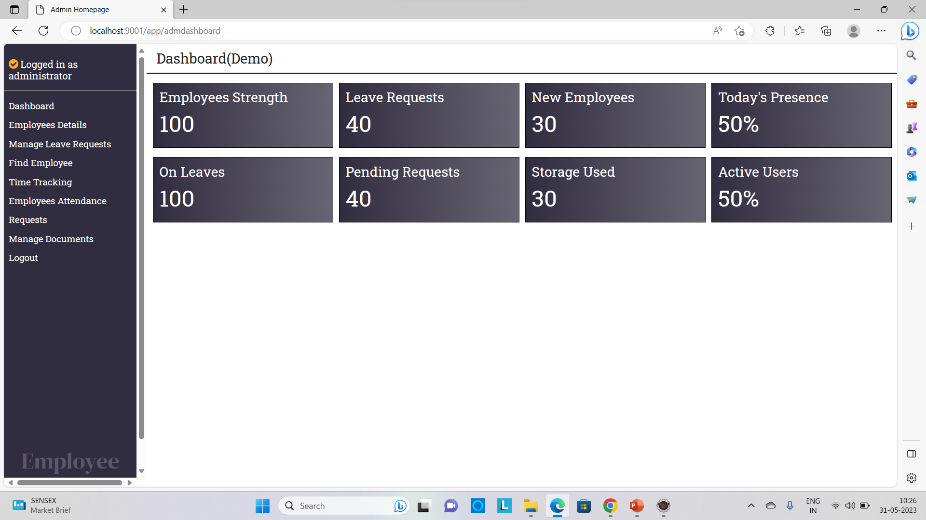
Appendices

Slide 23
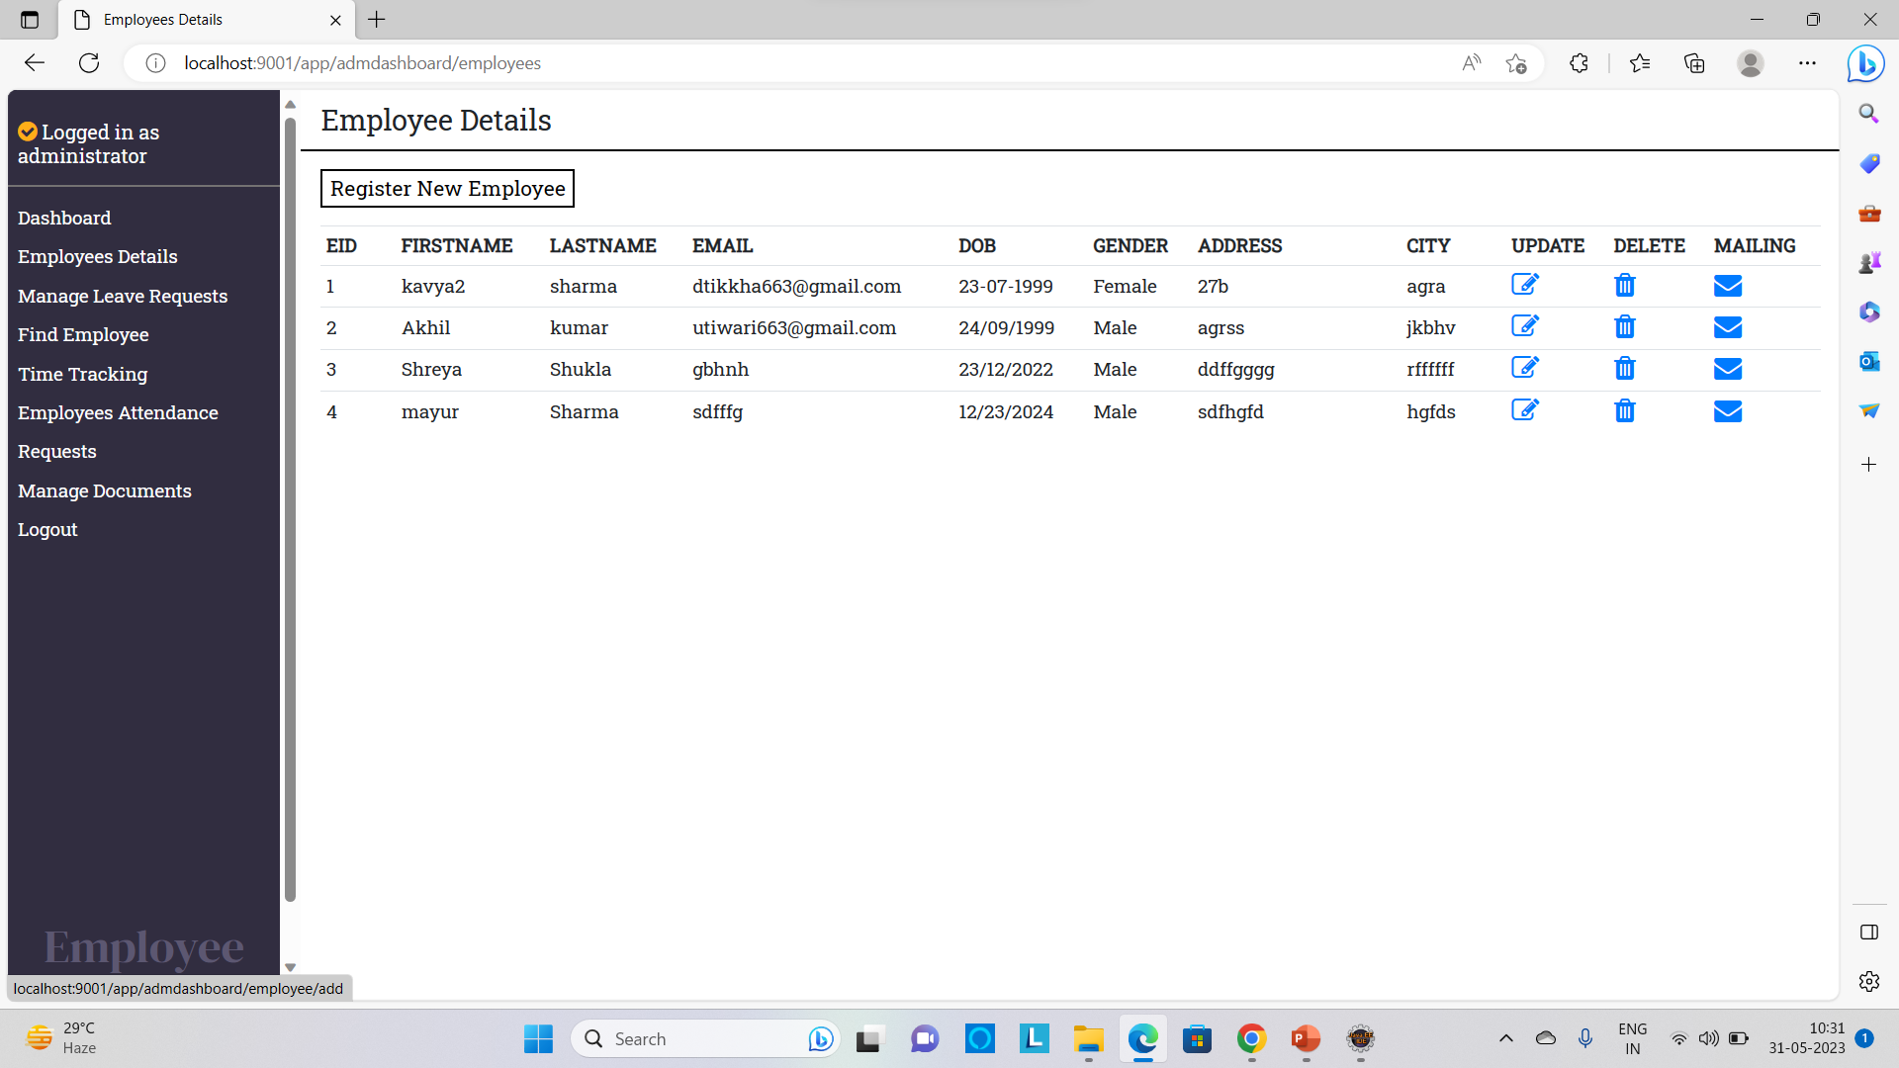
Appendices

Slide 24
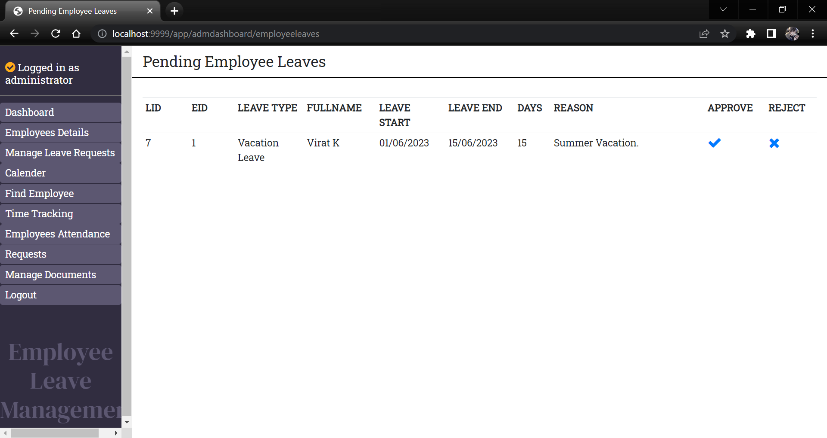
Appendices

Slide 25
Github link
1.https://github.com/Utiwari664/project_office_leave_management_system_by_utkarsh_tiwari

Slide 26
Thank you !!

